Slide 1
Attrition Intelligence Dashboard
From Hiring to Exit: Understanding & Reducing Talent Attrition
Presented by: Shubham Sinha Last Updated: June 9th, 2025

Slide 2
Deliverables
Objective
An HR department wants to overhaul their reporting by creating a full-journey dashboard from hiring to resignation. The aim is to improve talent retention and manager effectiveness.
Attrition heatmaps and forecasting indicators
Correlation matrix between job roles, satisfaction, and turnover
HR KPI report with filters by tenure and department

Slide 3
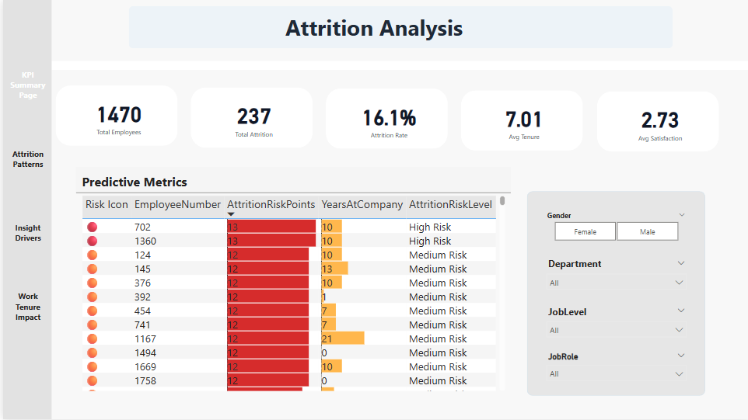
Overview of Dashboard

Slide 4
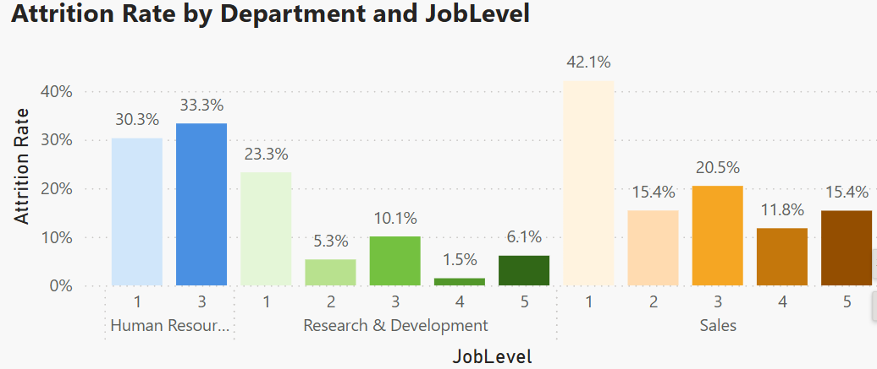
Departmental Breakdown
Sales Representatives at Level 1 are the ones with the highest attrition rate at 42.1%, followed by Human Resources and Laboratory Technicians at Level 3.
From an overview, it is clear that the Research and Development department is doing well in terms of Attrition.

Slide 5
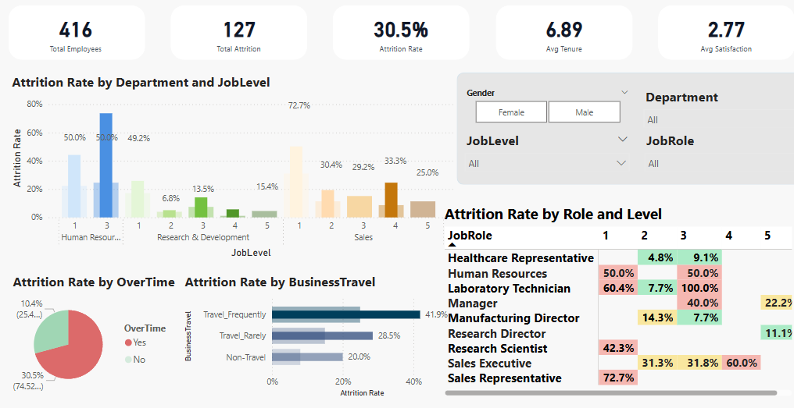
Travel and Over Time
One of the major factors for Attrition Rate is Over Time and Travel Frequency
Across different job roles, Level 1 and Level 2 are most affected by this.

Slide 6
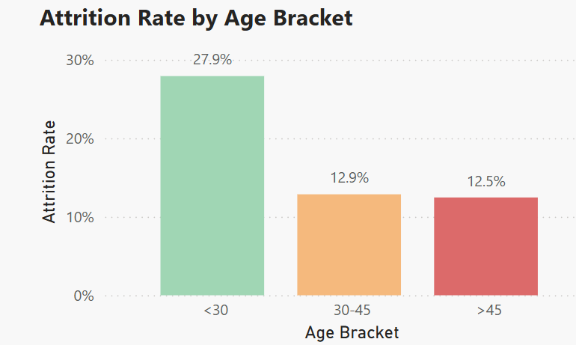
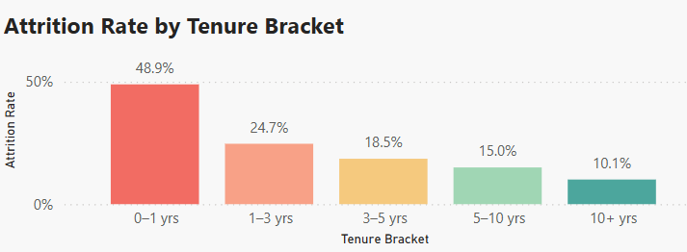
Attrition By Age
People who are younger (below 30) seem to switch jobs more frequently compared to those above 30.
And if we correlate this with Tenure Bracket, it becomes very clear — younger employees with shorter tenure are significantly more likely to leave.

Slide 7
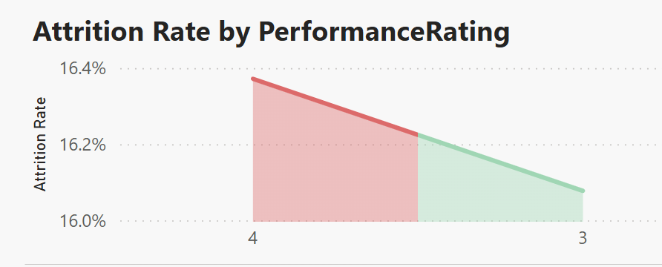
Performance Rating
- People who perform better are more likely to leave, and this requires some serious measures.

Slide 8
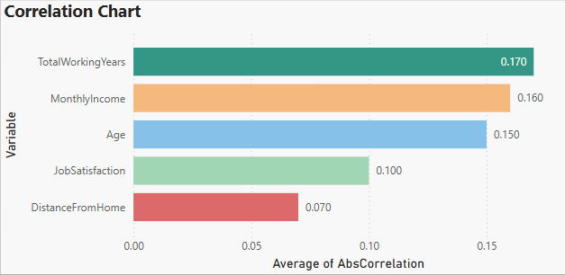
Correlation Chart
Total Working Years has the highest correlation (0.170) with attrition, indicating that people with more or fewer years of experience show different patterns of leaving the organization.
Monthly Income and Age also show moderate correlation (0.160 and 0.150, respectively), suggesting compensation and age group are key drivers behind attrition behavior.
Job Satisfaction shows a lower correlation (0.100), meaning it’s important but not the strongest predictor in isolation.
Distance From Home has the weakest correlation (0.070), implying it's not a primary factor for attrition in this dataset.

Slide 9
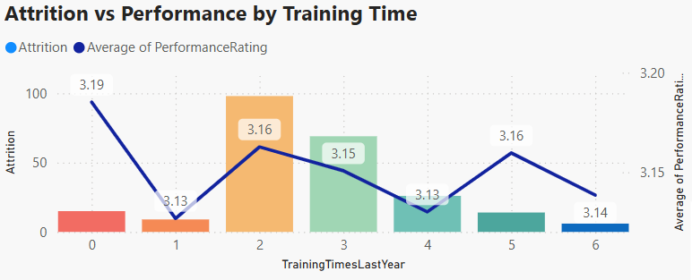
Attrition vs Performance by Training Time
Employees who received 0 or 1 training sessions show higher average performance ratings (3.19 and 3.13) but still experience notably high attrition.
Training Time = 2 is where attrition spikes to its highest, while performance slightly drops to 3.16, suggesting this group may be disengaged despite moderate performance.
Across all training frequencies, the performance rating remains fairly stable (around 3.13 to 3.19), but attrition fluctuates, indicating training alone doesn’t directly influence performance.
Notably, higher training frequencies (5 and 6) don’t show clear reduction in attrition or notable increase in performance.

Slide 10
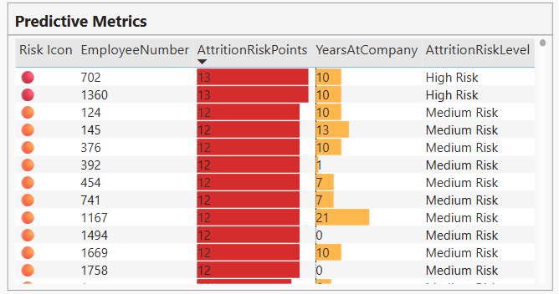
Predictive Metric

Slide 11
Recommendation:
Sales Representatives at level 1 show the highest attrition rate (42.1%), followed by Human Resources and Laboratory Technicians at level 3.
These segments require focused intervention.Roles and Levels where Business Travel is Very Frequent and OverTime is high appear to be one of the major reasons behind attrition.
People who are younger (below 30) seem to switch jobs more frequently compared to those above 30. When correlated with tenure brackets, it becomes evident that younger employees with lower tenure are more likely to leave.
People who perform better are more likely to leave, and this requires serious attention to ensure high performers are engaged and retained.
Total Working Years, Monthly Income, and Age are the top three correlated variables with attrition. This clearly shows that career stage and financials are stronger predictors than location-related factors like Distance From Home.
The current training programs show no strong direct relationship with retention or performance improvement. High attrition exists across both low and high training frequencies, while performance remains nearly flat. Training quality, relevance, and timing should be re-evaluated rather than increasing quantity.

